Slide 1
cloaking contact fingers and busbars on solar cells
Task:
Find a surface, which
- refracts the lights to the optic active area
- functions for a as large as possible inclination-angle interval
- maps the light as uniform as possible on the optical active areas
What has been done:
- Solved the 1-dimensional problem, which fulfills our requirements perfectly.
- no analytical solution for the 2-dimensional problem, which fulfills our requirements perfectly.
→ We try to blend the both 1-dimensional solution (in different directions) in order to fulfill our requirements as good as possible

Slide 2
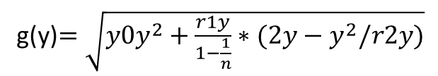





Blending of the solution in x-direction and the solution in y-direction
1D-Solutions:
Assumption: z(x,y)$=z(f\left(x\right),g\left(y\right))$
f(x)$=\sqrt{y0x^{2}+\frac{r1x}{1−\frac{1}{n}}∗(2x−x^{2}/r2x)}$
bleding suggestions:
z1(x,y)$=a∗f\left(x\right)+b∗f\left(y\right)$
g(y)$=\sqrt{y0y^{2}+\frac{r1y}{1−\frac{1}{n}}∗(2y−y^{2}/r2y)}$
z2(x,y)$=\sqrt{a∗f{\left(x\right)}^{2}+b∗g{\left(y\right)}^{2}}$
z2(x,y)$=f\left(x\right)∗g(y)$

Slide 3

Optimized surface for normal incidence
The solution z2(x,y) with optimal a and b is a almost perfect solution:
- the average distance between the point the rays hits the solar cell and the design point
the number of rays, which hit the contact
fitnessfunction to optimize the surface for normal incidence:
z2(x,y)$=\sqrt{a∗f{\left(x\right)}^{2}+b∗g{\left(y\right)}^{2}}$
fitness1$=\left(numberofgrids+1\right)∗averageDistancetoDesignPoint$

Slide 4
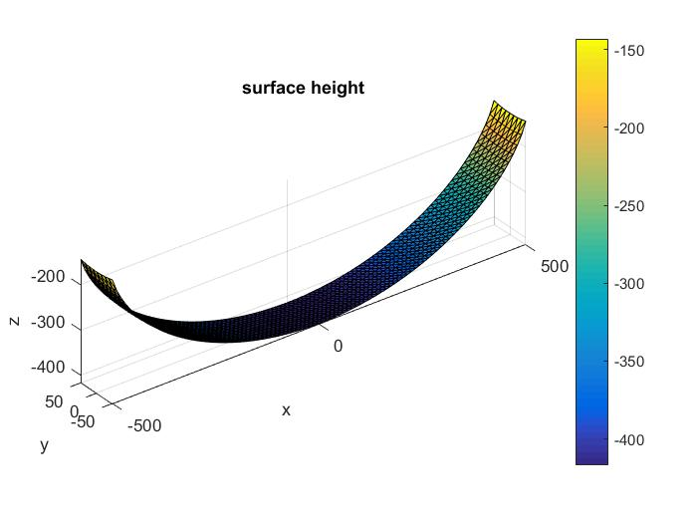
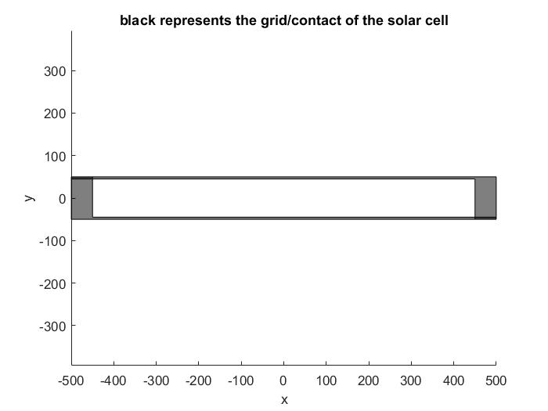
Optimized surface for normal incidence

Slide 5
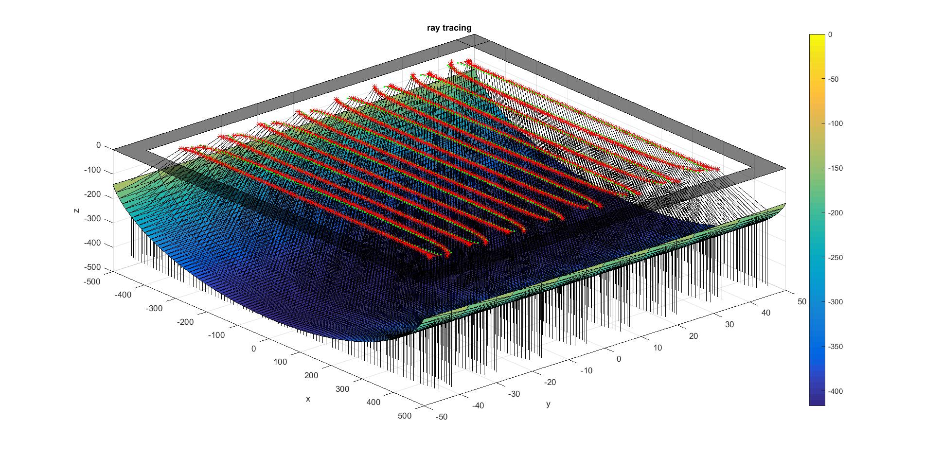
Optimized surface for normal incidence

Slide 6
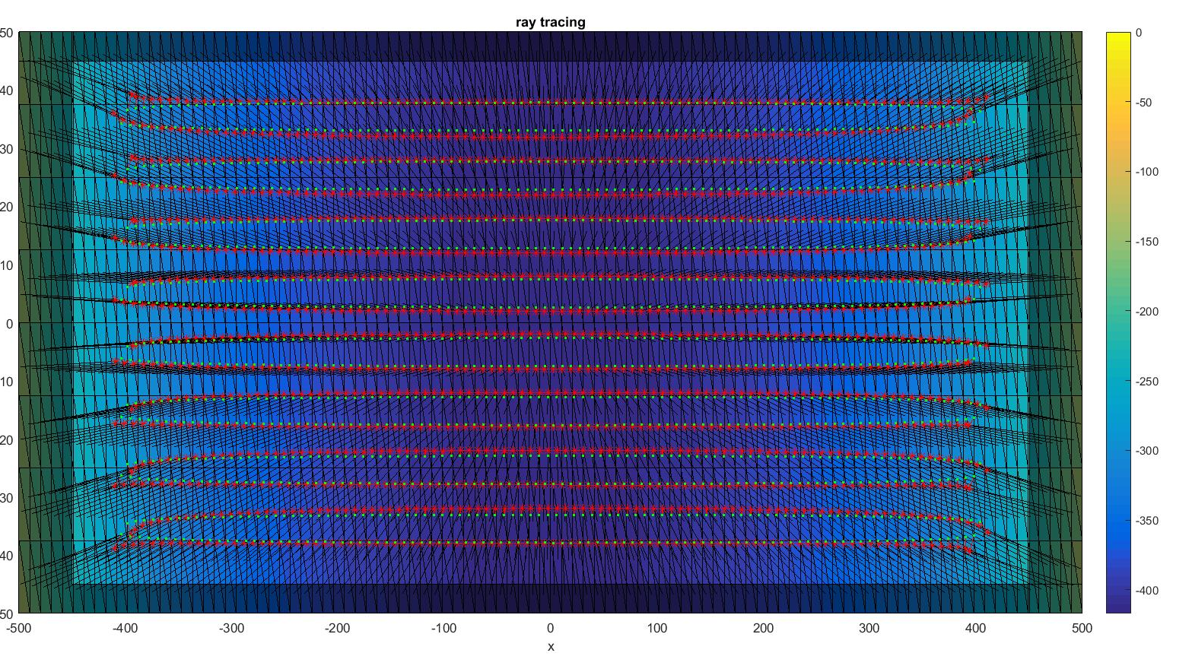
Optimized surface for normal incidence
green points are design-points
red points are the points the rays hit the solar cell

Slide 7
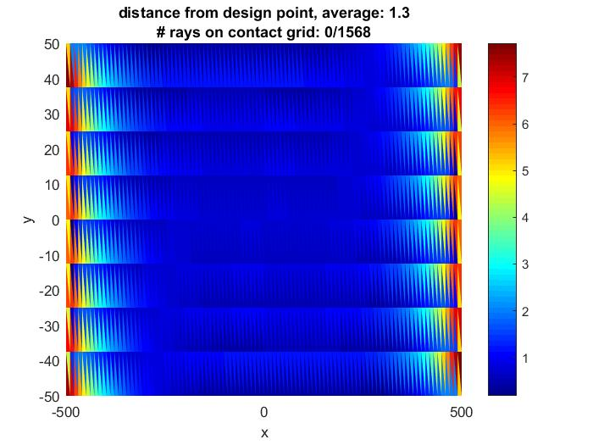
Optimized surface for normal incidence
average distance from design point

Slide 8
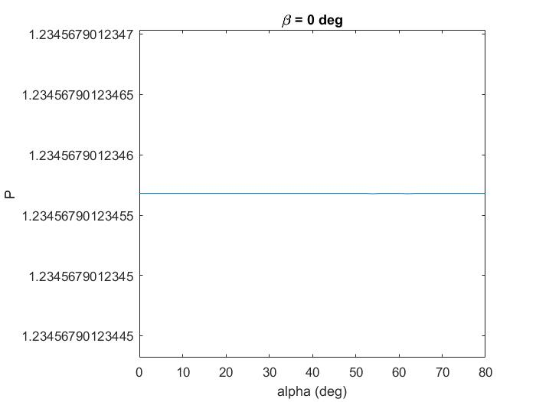
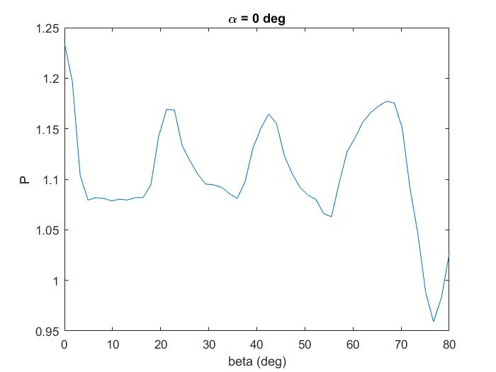
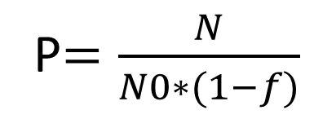
Angle dependance of the solution optimised for normal incidence with fitness1-function
f=1-sx*sy;
N0=totalNumberofRays;
N=totalNumberofRays-numOnContactGrid;
P$=\frac{N}{N0∗(1−f)}$

Slide 9
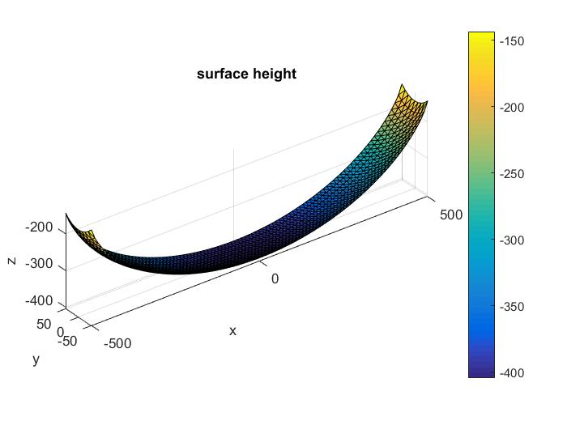
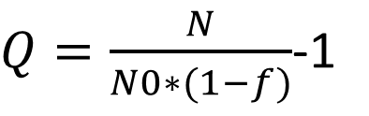
optimised concerning average improvement over one year
relative Improvement (Q):
$Q=\frac{N}{N0∗(1−f)}$-1
From now on the fitness is described by the annual Improvement P=Q+1

Slide 10
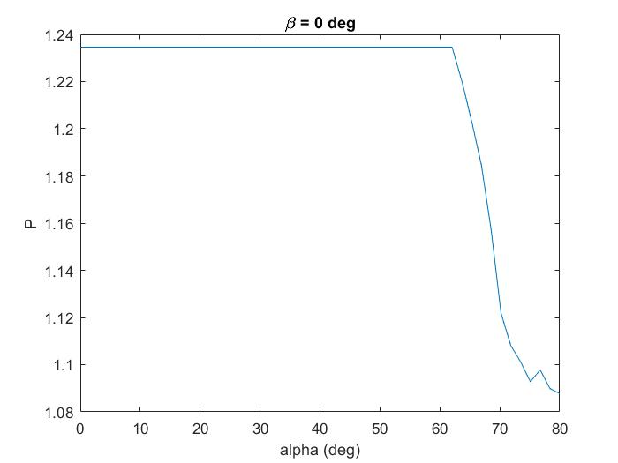
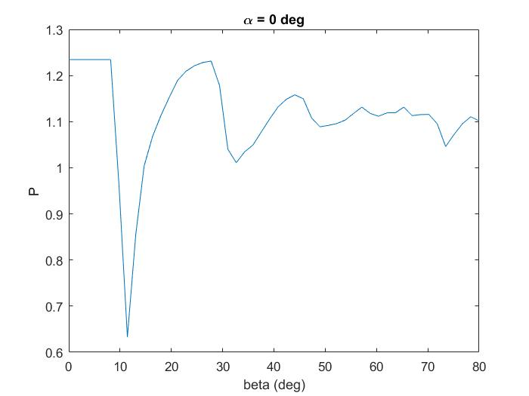
Angle dependance of the solution using the annual Improvement

Slide 11
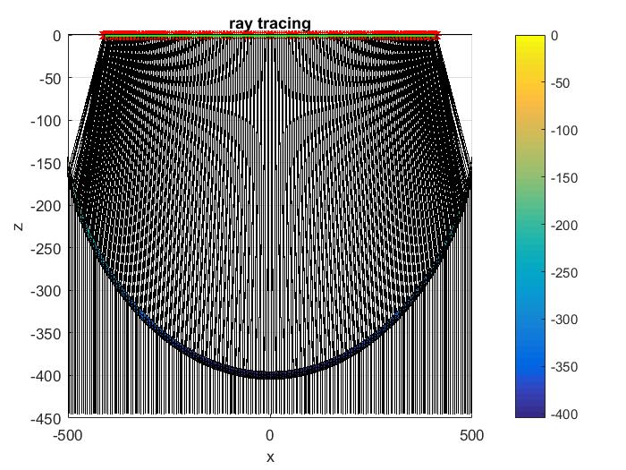
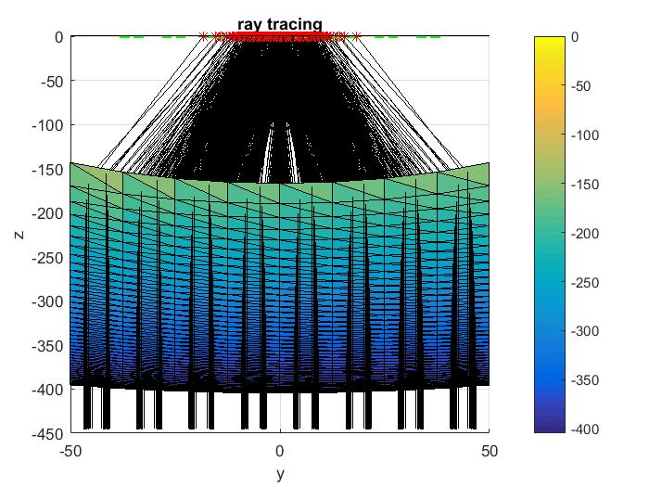
optimised concerning average improvement over one year
Normal Incidence, x-z plane
Normal Incidence, y-z plane

Slide 12
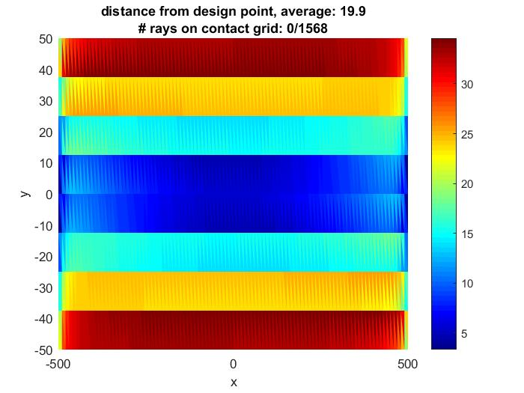
optimised concerning average improvement over one year
This plot is made with Normal incidence
(alpha=beta=0)
average distance from design point

Slide 13
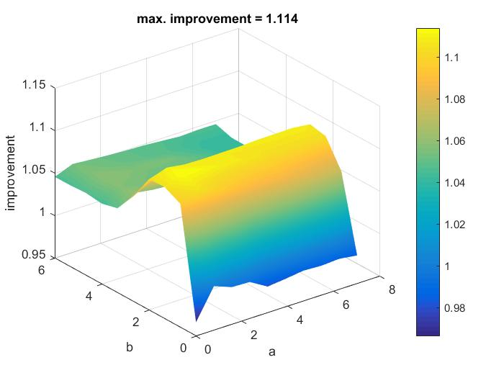
Parameterplot to show the impact of a and b
constant parameter:
y0y=50
y0x=50
rx1=50
rx2=500
ry1=5
ry2=50

Slide 14


Comparing annual Improvement of different results
a | b | y0x | y0y | rx1 | ry1 | P (annual Improvement) | optimisation
2.07 | 5.00 | 49.77 | 55.54 | 51.00 | 9.46 | 1.1371 | annualImpr.
1.9 | 2.0 | 75 | 70 | 50 | 5 | 1.1071 | normalinc.
1 | 0 | 50 | 0 | 50 | 0 | 1.1025 | only f(x)
0 | 1 | 0 | 5 | 0 | 5 | 1.0789 | only g(y)
optimisation | annual improvement normalised to maximal annual improvement
optimised concerning annual Improvement (annualImpr.) | 58.43%
optimised concerning normal Inclination (normalinc.) | 45.65%
only f(x) | 43.69%
only g(y) | 33.63%
Z(x,y)$=\sqrt{a∗f{\left(x,y0x,rx1\right)}^{2}+b∗g{\left(y,y0y,ry1\right)}^{2}}$
P_max$=1+\frac{1−sx∗sy}{sx∗sy}$=1.2346

